Slide 1
StreamingApp: End-to-End DevOps Pipeline
A React frontend and 4 Node.js microservices, delivered to AWS EKS with Jenkins, Terraform, Ansible, Helm, Prometheus, Grafana and Slack
Docker
Jenkins
Terraform
Ansible
Helm
EKS
Prometheus
Grafana
Slack
Final presentation | Capstone project | November 2026
Notes:
Introduce the project: a video streaming app (React + 4 Node microservices + MongoDB) taken from local Docker to a fully automated AWS EKS deployment over 6 sprints.

Slide 2
The project at a glance
5
3
12
6
container images
Jenkins pipelines
custom alert rules
sprints delivered
frontend, auth, streaming, admin, chat
infra -> ansible -> app, one chain
app, nodes and Jenkins, to Slack
Dockerize to final E2E testing
1
Build
2
CI/CD
3
Infrastructure
Docker multi-stage images, Amazon ECR
Jenkins on EC2, GitHub webhook, Multibranch
Terraform, state in S3 + DynamoDB lock
4
Configuration
5
Deploy
6
Observe
Ansible: EC2 tools, EKS add-ons, secrets
Helm chart to EKS, ALB Ingress, HPA
Prometheus, Grafana, Alertmanager, Slack

Slide 3
Architecture: from git push to live on EKS
webhook
push
Developer
(git push)
GitHub
repository
Jenkins on EC2
c7i-flex.large
Amazon ECR
5 repos
S3 videos
bucket
Slack
#devops-alerts
helm upgrade
image pull
alerts
namespace: streamingapp (Helm release)
namespace: monitoring
frontend (nginx) :80
auth-service :3001
Prometheus
End users
(browser)
ALB
(Ingress)
Alertmanager
streaming-service :3002
admin-service :3003
Grafana
AWS VPC 10.0.0.0/16
EKS 1.35
4 x t3.small Spot
nodes, private subnets
chat-service :3004
MongoDB StatefulSet
20 Gi gp3
node-exporter +
kube-state-metrics
HPA on auth, streaming, chat | liveness + readiness probes

Slide 4

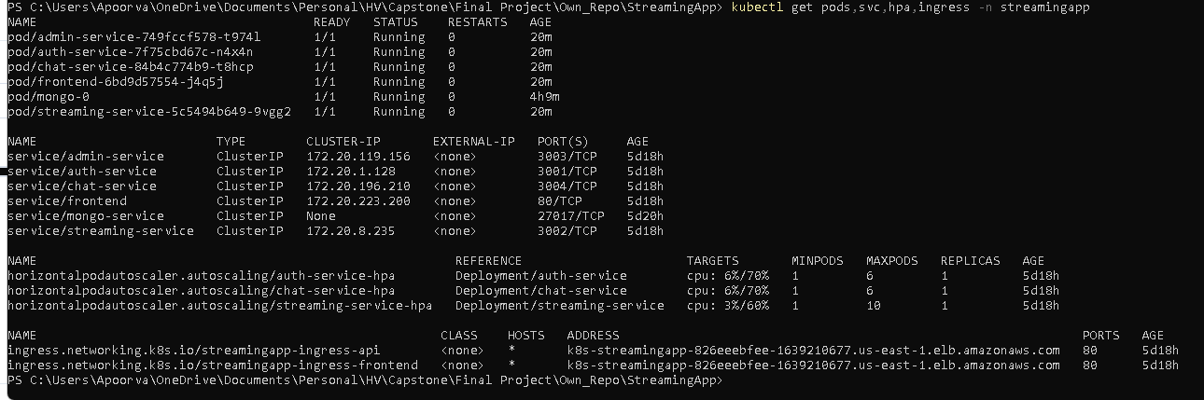
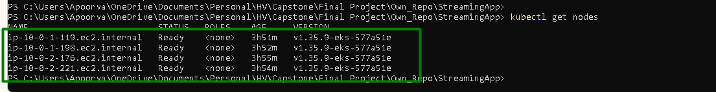
The result: StreamingApp live on EKS
Pods, Services, HPAs and Ingress
4 worker nodes, all Ready
6 pods 1/1 Running, 0 restarts
All Services internal (ClusterIP); one ALB for / and /api
4 x t3.small Spot nodes across 2 private subnets
React frontend served through the ALB

Slide 5
Six sprints, one delivery chain
1
2
3
4
5
6
Sprint 1
Sprint 2
Sprint 3
Sprint 4
Sprint 5
Sprint 6
Dockerize
Provision
Configure
Deploy
Observe
Validate
Multi-stage Dockerfiles, Jenkins on EC2, IAM role access, GitHub webhook
Terraform: VPC, subnets, EKS, EC2, SGs; state in S3; infra job
Ansible playbooks for EC2 and EKS; job triggered after Terraform
Multi-stage CI/CD: test, build, ECR, Helm to EKS, probes + HPA
Prometheus, Grafana dashboards, 12 alerts, Slack notifications
Test suites in every pipeline, automated chain, end-to-end test

Slide 6
Execution steps (RUNBOOK phases 0 to 11)
Phase | What we did | Result
0 Laptop prerequisites | AWS CLI v2, Terraform 1.15.7, kubectl, Helm, Docker Desktop, WSL with Ansible | Tools at pinned versions
1 Local validation | Unit tests, alert-rule tests, docker compose stack incl. /metrics | App runs locally
2 AWS access + backend | IAM user + access key, S3 state bucket, DynamoDB lock table, admin /32 | Terraform backend ready
3 Latest code | Pull the Sprint-3 branch that the Jenkins jobs build from | Code in sync
4 Terraform (laptop) | terraform plan / apply: VPC, EKS, node group, Jenkins EC2, ECR, S3, IAM | AWS infrastructure up
5 Ansible (WSL) | Install Jenkins, Docker, kubectl, Helm, Terraform, node_exporter on EC2 | Jenkins server configured
6 Jenkins setup | Unlock, plugins, 7 credentials, Slack app, 3 jobs, GitHub webhook | CI/CD ready
7 Run the pipelines | infra -> ansible -> app as one chain, then a git push | App live behind the ALB
8 Verification | Image tags, immutable ECR, HPA load test, screenshots | Evidence captured
10 Monitoring | Prometheus targets, Grafana dashboards, alerts + Jenkins notices in Slack | Alerting proven
11 Testing | Test suites, end-to-end validation from push to EKS | Final sign-off
9 Teardown (last) | terraform destroy, empty ECR/S3, delete state bucket + lock table | No running cost

Slide 7
AWS resources: network and compute (Terraform)
Resource | Specification | Why
VPC | 10.0.0.0/16 across 2 AZs (us-east-1a, us-east-1b) | Isolated network for the cluster
Subnets | 2 public /24 (ALB, NAT) | 2 private /24 (EKS nodes) | Nodes are not reachable from the internet
NAT gateway | Single NAT gateway | Outbound access for private nodes at lower cost
EKS cluster | Kubernetes 1.35; public endpoint only for the admin /32, private endpoint for Jenkins; add-ons coredns, kube-proxy, vpc-cni, EBS CSI (pinned) | Managed control plane
Node group | 4 x t3.small Spot (min 4, max 6), AL2023, 20 GB disk | Room for ~34 pods at Spot prices
Jenkins EC2 | c7i-flex.large (2 vCPU, 4 GB), Ubuntu 22.04, 30 GB disk, Elastic IP | Builds need 4 GB; stable webhook URL
Security group | 22/8080 from admin /32; 8080 from GitHub webhook ranges; 8080/9100 from private subnets | Least-privilege access to Jenkins
Load balancer | ALB created by the AWS Load Balancer Controller from the Ingress | Single public entry point

Slide 8
AWS resources: registry, storage and access
Resource | Specification | Why
Amazon ECR | 5 repositories (streamingapp/*), IMMUTABLE tags, scan on push, keep last 10 images | A git-SHA tag always means one build
S3 videos bucket | Versioned, server-side encrypted, public access blocked, Intelligent-Tiering | Media storage for the streaming service
Terraform state | S3 bucket streamingapp-tfstate (key eks/terraform.tfstate) + DynamoDB lock table | Shared state, no concurrent applies
Jenkins IAM role | streamingapp-jenkins-role via EC2 instance profile | No static AWS keys in Jenkins
IRSA roles | AWS Load Balancer Controller and EBS CSI driver | Pods get only the AWS rights they need
EKS access entries | Admin IAM user and Jenkins role as cluster admins | kubectl/helm from laptop and pipelines
Node IAM policy | S3 access for the videos bucket | Streaming service reads media

Slide 9
Kubernetes workloads (Helm chart)
Workload | Port | Requests (CPU / mem) | Limits (CPU / mem) | Scaling
frontend (nginx) | 80 | 50m / 64Mi | 200m / 128Mi | 1 replica
auth-service | 3001 | 100m / 128Mi | 300m / 256Mi | HPA 1-6 at 70% CPU
streaming-service | 3002 | 200m / 256Mi | 500m / 512Mi | HPA 1-10 at 60% CPU (prod)
admin-service | 3003 | 100m / 128Mi | 300m / 256Mi | 1 replica
chat-service | 3004 | 100m / 128Mi | 300m / 256Mi | HPA 1-6 at 70% CPU
MongoDB (StatefulSet, mongo:6) | 27017 | 250m / 512Mi | 500m / 1Gi | 1 replica + 20 Gi gp3 volume
Probes
Safe deploys
Images
Liveness and readiness probes on every service; failing pods are restarted or removed from the Service
helm upgrade --atomic --wait rolls back automatically if new pods fail health checks
global.imageTag = git SHA; the chart refuses an empty or 'latest' tag

Slide 10
Cluster add-ons and monitoring stack
Component | Installed by | Specification
metrics-server | Ansible (Helm 3.14.0) | CPU metrics for the HPAs
AWS Load Balancer Controller | Ansible (Helm 1.17.1) | Creates the ALB from the Ingress (IRSA role)
gp3 StorageClass | Ansible | Default class for EBS volumes (MongoDB, Prometheus)
kube-prometheus-stack | Ansible (Helm 92.3.1) | Prometheus Operator, Prometheus, Alertmanager, Grafana
Prometheus | kube-prometheus-stack | 100m/400Mi to 500m/900Mi; scrape 30s; retention 3 days / 4 GB; 5 Gi gp3
Alertmanager | kube-prometheus-stack | 10m/32Mi to 100m/128Mi; Slack webhook from a Kubernetes Secret
Grafana | kube-prometheus-stack | 50m/300Mi to 500m/512Mi; dashboards provisioned from ConfigMaps
node-exporter, kube-state-metrics | kube-prometheus-stack | Node and Kubernetes object metrics (small requests)

Slide 11
Three Jenkins pipelines, one automatic chain
streamingapp-infra
streamingapp-ansible
streamingapp-app
Type
Type
Type
Pipeline job (parameterised)
Pipeline job (parameterised)
Multibranch Pipeline
Trigger
Trigger
Trigger
Manual: Build with Parameters, ACTION = plan | apply
Automatic after a successful infra apply; or manual
GitHub push (webhook); or triggered by the ansible job
What it means
What it means
What it means
Provisions AWS with Terraform. Plan, human approval, apply.
Configures EC2 and EKS: tools, add-ons, secrets, monitoring stack.
Tests, builds, pushes to ECR and deploys the app to EKS with Helm.
Chain: infra apply -> ansible -> app. A git push runs only the app pipeline. Deploy stages run only on main, Develop and Sprint-3; other branches test and build only. All three post failures to Slack #devops-alerts.

Slide 12
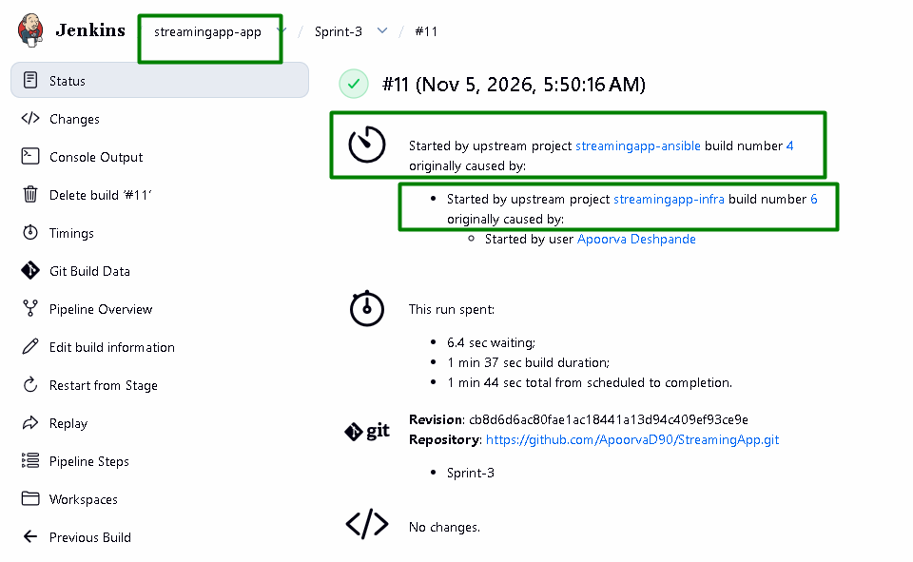
The chain in action: one click runs all three pipelines
1
streamingapp-infra #6
Started by user. Terraform plan, approval, apply; on success it triggers the ansible job.
2
streamingapp-ansible #4
Started by upstream infra #6. Configures EC2 and EKS, verifies infrastructure and monitoring, then triggers the app.
3
streamingapp-app » Sprint-3 #11
Started by upstream ansible #4. Unit tests, build and push, Helm deploy, then deployment, API and monitoring tests.
streamingapp-app #11: the trigger history recorded by Jenkins
A git push runs only step 3, through the GitHub webhook.

Slide 13
Pipeline 1: streamingapp-infra (Terraform)
Type
1
Init & Validate
terraform init with the S3/DynamoDB backend, fmt -check, validate
Pipeline job, Jenkinsfile.infra
2
Plan
terraform plan -out=tfplan; admin_cidr from a Jenkins credential; tfplan.txt archived
Trigger
Manual: Build with Parameters
3
Approve
Manual input step: a person reviews the plan before anything changes (apply only)
Parameter
4
Apply
terraform apply of the exact saved plan
ACTION = plan (preview) or apply (provision)
5
Post: success
Triggers streamingapp-ansible (configuration follows provisioning)
Safety
Approval gate; destroy is laptop-only (Jenkins runs on this infra)
Post: failure
Slack message to #devops-alerts with the build link
6
Options
No concurrent builds, 60 min timeout

Slide 14
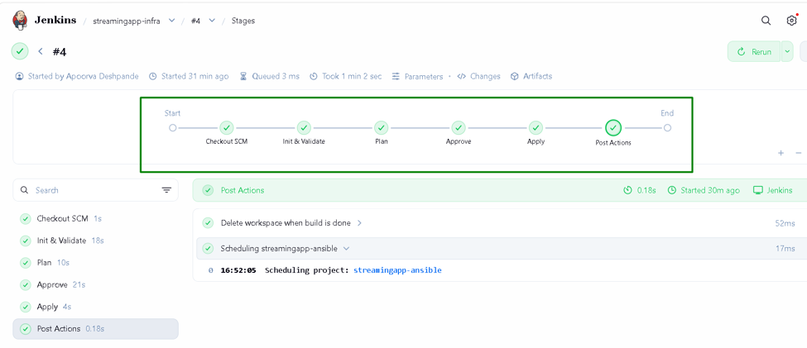
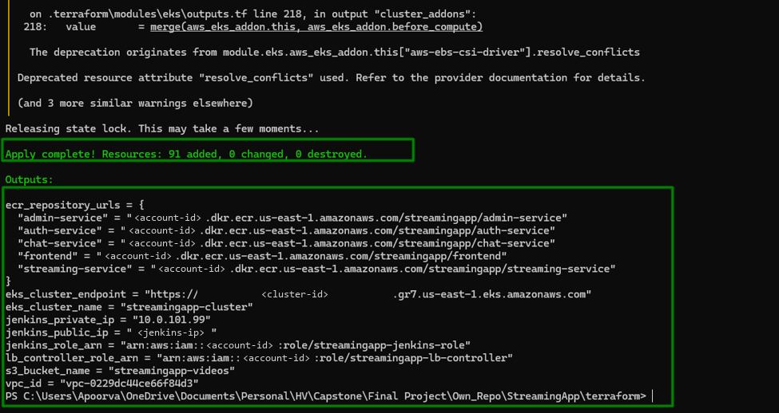
Pipeline 1 in action: Terraform provisions AWS
streamingapp-infra stage view: init, plan, approve, apply
First apply: 91 resources added (IDs masked)
Re-runs on unchanged code show 0 added, 0 changed, 0 destroyed: Terraform is idempotent, so the job also proves there is no drift.

Slide 15
Pipeline 2: streamingapp-ansible (configuration)
Type
1
Read Terraform outputs
VPC ID, LB controller role, S3 bucket, Jenkins private IP, ALB host
Pipeline job, Jenkinsfile.ansible
2
Test alert rules
promtool checks + unit tests; a broken rule stops the run early
Trigger
Automatic after infra apply; or manual
3
Configure EC2
site.yml on the Jenkins host (Docker, kubectl, Helm, node_exporter)
Parameters
4
Configure EKS
k8s-bootstrap.yml: metrics-server, LB controller, gp3, namespace, secrets, monitoring
APP_URL (CORS, auto-detected), TRIGGER_APP_DEPLOY, APP_BRANCH
5
Verify infrastructure
verify-infra.sh: EKS, nodes, subnets, NAT, SG, IAM, S3, state, ECR
Secrets
SSH key, JWT, Grafana and Slack credentials from Jenkins
Verify monitoring
verify-monitoring.sh: components, scrape targets, rules, Grafana
6
Options
Post: success
Triggers streamingapp-app/<APP_BRANCH> to deploy
No concurrent builds, 30 min timeout
7

Slide 16
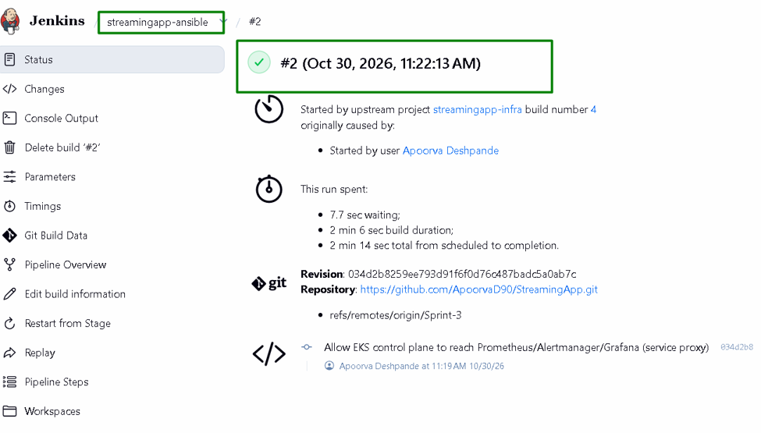
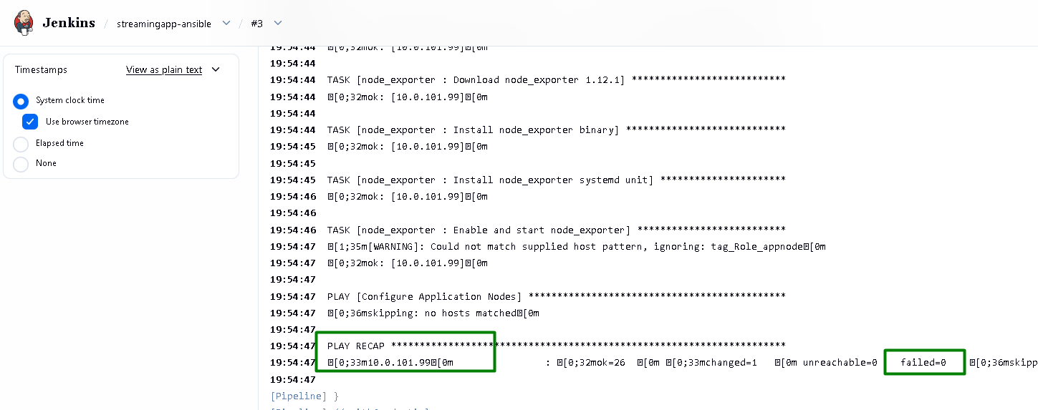
Pipeline 2 in action: Ansible configures EC2 and EKS
PLAY RECAP: ok=26, changed=1, unreachable=0, failed=0
Started automatically by upstream streamingapp-infra
Idempotent: a re-run changes almost nothing. The app-node play is skipped by design, because the app runs on EKS, not on EC2.

Slide 17
Pipeline 3: streamingapp-app (CI/CD)
Type
1
Checkout
Source, image tag = git SHA, account ID resolved at runtime
Multibranch Pipeline, root Jenkinsfile
2
Unit Tests
5 parallel Jest suites: 4 services + frontend
Trigger
GitHub push webhook; or the ansible job
3
Docker Build & Push
Build 5 images, push to ECR; skip if that SHA already exists
4
Deploy to EKS
MongoDB StatefulSet, helm upgrade --atomic, Ingress, CORS secret
Branches
All: test + build + push. main, Develop, Sprint-3: also deploy + tests
5
Deployment Tests
Rollouts, image tags, probes, HPAs, /api/health, /metrics
Image tag
API Tests
Through the ALB: register, login, JWT, access control, videos
8-character git SHA, immutable in ECR
6
7
Monitoring Check
Prometheus scrapes the new pods; alerts, Grafana up
Options
No concurrent builds, 45 min timeout
Post
Slack on success and failure; prune old images, clean workspace
8

Slide 18
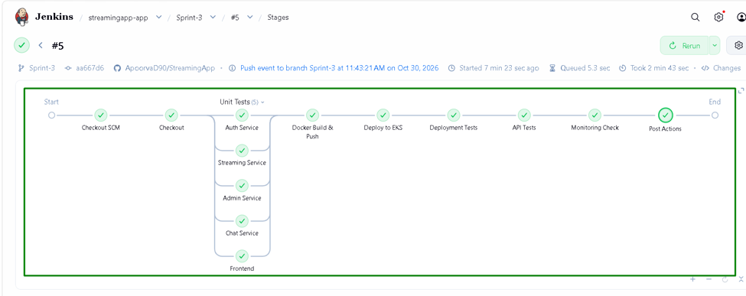
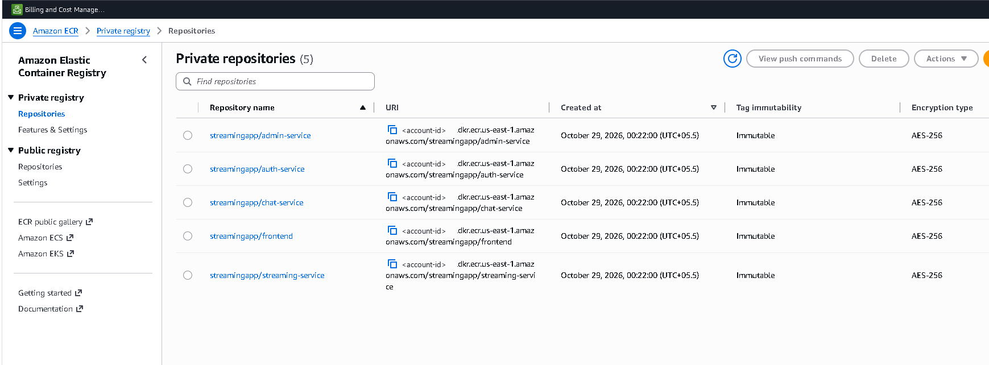
Pipeline 3 in action: test, build, push, deploy
Every stage green, incl. 5 parallel unit test suites
5 ECR repositories: immutable tags, scan on push
Each image is tagged with the 8-character git SHA, so what runs on EKS is traceable to an exact commit. 'latest' is never used.

Slide 19
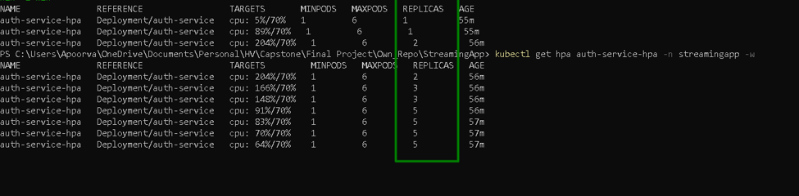
Running on EKS: autoscaling under load
What this shows
Liveness + readiness probes keep only healthy pods in service
HPAs on auth, streaming and chat scale on CPU (min 1)
MongoDB is a StatefulSet with its own 20 Gi gp3 volume
Helm --atomic rolls back a failed release automatically
Deployed resources in the streamingapp namespace
HPA load test: CPU rises above target, replicas scale out

Slide 20
Monitoring: what we measure and how alerts travel
What Prometheus scrapes (every 30 s)
Alert route to Slack
1
App services
Rule fires
Condition true for its 'for' duration
/metrics on 4 backends via ServiceMonitors: requests, 5xx, latency
2
Nodes
Alertmanager
Groups by alertname + namespace; waits 30 s
node-exporter: CPU, memory, disk on each node
Kubernetes
Slack
#devops-alerts: FIRING, then RESOLVED
3
kube-state-metrics: deployments, pods, restarts
Jenkins
group_interval 5m | repeat_interval 4h | send_resolved
Critical alerts inhibit the matching warning
Watchdog goes to a null receiver (proves the pipeline is alive)
4
Prometheus plugin: job results, queue; host node_exporter :9100

Slide 21
The 12 custom alert rules and their thresholds
Alert | Fires when | For | Severity
AppServiceDown | A deployment has fewer than 1 available replica | 1m | critical
MongoDBDown | MongoDB StatefulSet has fewer than 1 ready replica | 2m | critical
AppMetricsTargetDown | Prometheus cannot scrape an app target (up == 0) | 2m | warning
AppHighErrorRate | More than 5% of requests return 5xx | 5m | warning
AppHighLatency | p95 response time above 1 second | 10m | warning
AppPodRestarting | More than 3 container restarts in 15 minutes | - | warning
HostHighCPU | Node CPU above 85% | 10m | warning
HostHighMemory | Node memory above 90% | 10m | warning
HostDiskAlmostFull | Less than 15% disk space free | 10m | critical
JenkinsDown | Jenkins metrics endpoint unreachable (up == 0) | 2m | critical
JenkinsJobFailed | Last build result of a job is FAILURE | - | warning
JenkinsBuildQueueStuck | More than 3 builds waiting in the queue | 15m | warning

Slide 22
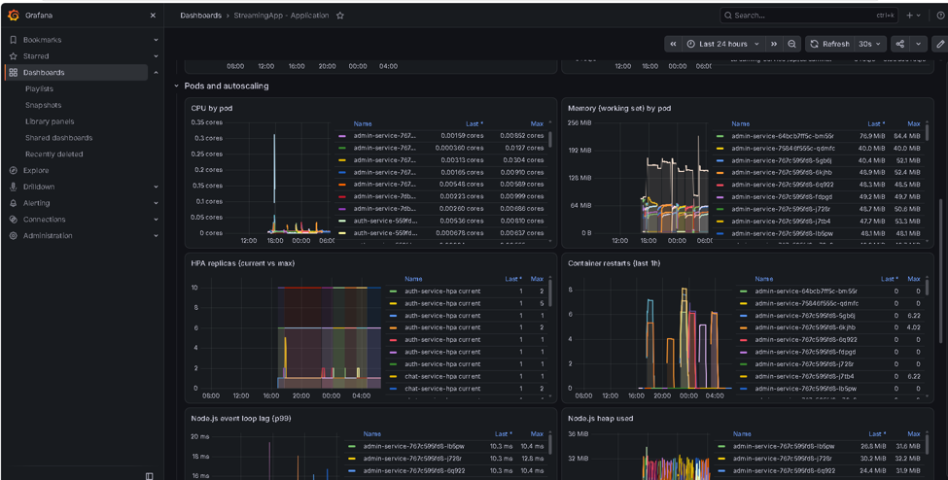
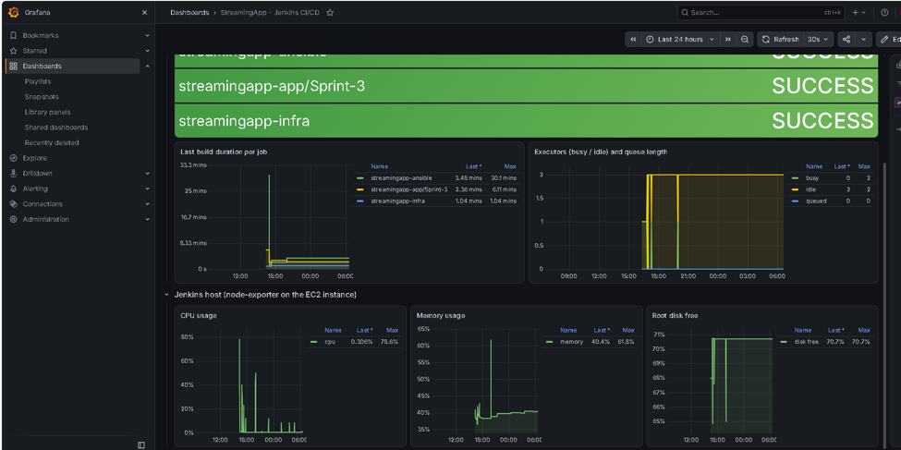
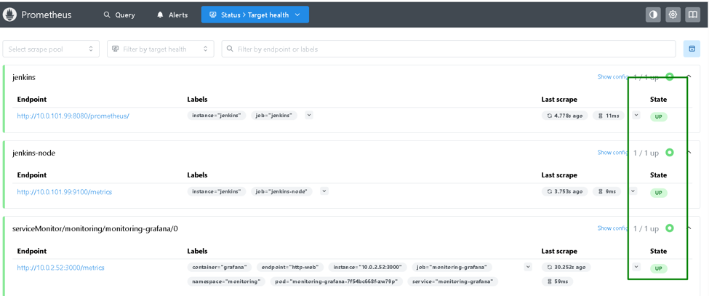
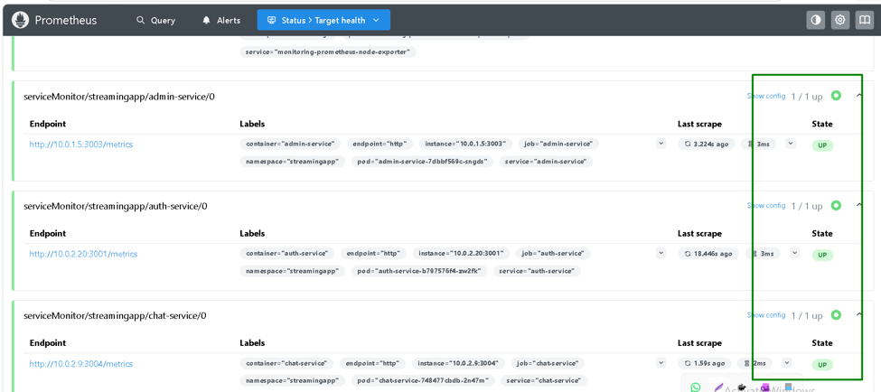
Monitoring in action: Prometheus and Grafana
Grafana: application dashboard
Grafana: Jenkins dashboard
Prometheus targets: app services up
Prometheus targets: Jenkins, nodes, cluster

Slide 23
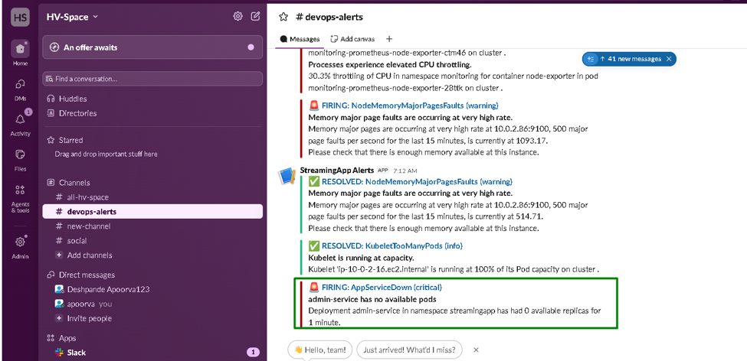
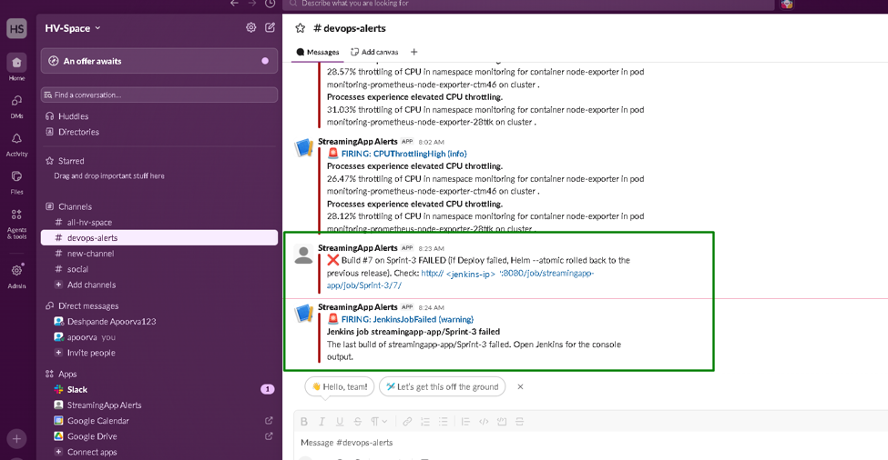
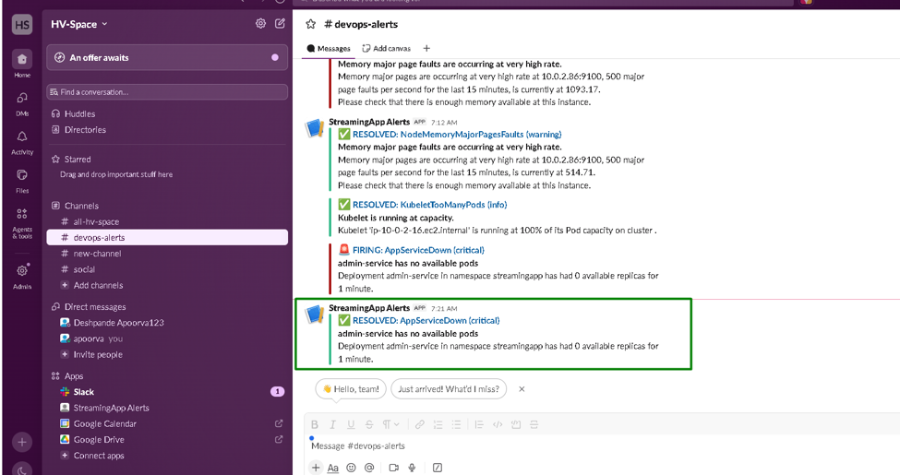
Alerts in action: Slack #devops-alerts
Alert FIRING
Jenkins build failure notice (a deliberately failing test)
Same alert RESOLVED
FIRING at 7:12, RESOLVED at 7:21: the gap is Alertmanager's 5-minute group_interval plus the rule's 'for' window.

Slide 24
Security and reproducibility rules
1
No secrets in code
2
Locked-down network
3
Pinned everything
Jenkins uses an EC2 IAM role: no static AWS keys
Account ID resolved at runtime, never hard-coded
Secrets live in Jenkins credentials and Kubernetes Secrets
Pods use IRSA roles with narrow rights
admin_cidr has no default; must be a single /32
EKS public API only for that /32
Jenkins reachable only from admin IP and GitHub webhook ranges
Nodes in private subnets behind NAT
Images tagged with the git SHA; no 'latest'
ECR tags immutable; scan on push
EKS add-ons, AMI, tools and Helm charts at exact versions
Terraform plan saved and applied as reviewed

Slide 25
Testing built into the pipelines (Sprint 6)
Test suite | What it checks | Runs in
Unit tests (Jest) | 4 backend services and the React frontend | app: Unit Tests
Alert rule tests (promtool) | Rule syntax + unit tests in alert-rules.test.yml | ansible: Test alert rules; laptop 1.1b
verify-infra.sh | EKS status, version, endpoints, add-ons, nodes, subnets, NAT, SG, IAM, S3, state, ECR | ansible: Verify infrastructure
verify-monitoring.sh | Monitoring pods, scrape targets up, rule groups, Alertmanager, Grafana | ansible + app: Monitoring Check
verify-deployment.sh | Rollouts, image tag = commit, probes, HPAs, /api/health, /metrics, ServiceMonitors | app: Deployment Tests
api-tests.sh | SPA, register, duplicate, login, JWT, admin 401/403, chat 401, video catalogue | app: API Tests
Every script prints PASS / FAIL per check and exits non-zero on any failure, which turns the Jenkins stage red and sends a Slack alert.

Slide 26
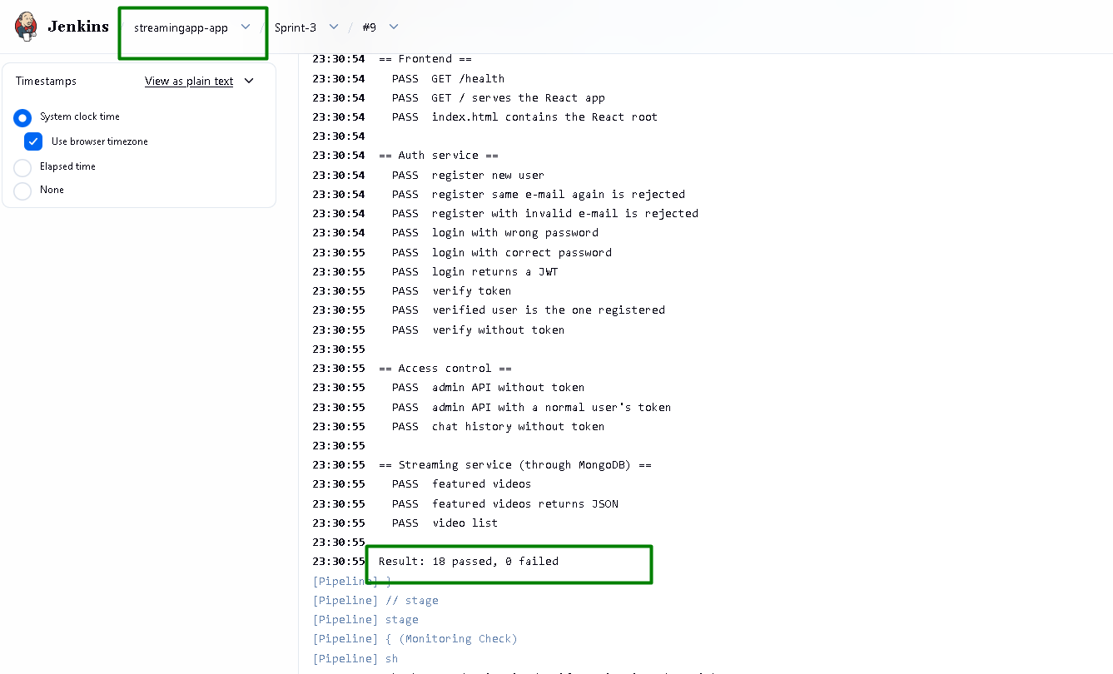
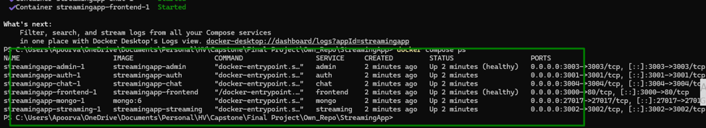
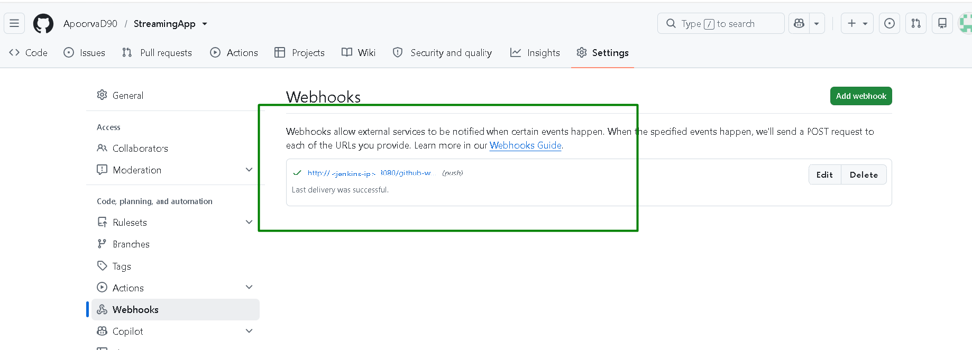
Tests in action: local to live
Local: full stack in Docker Compose
GitHub webhook: push events reach Jenkins
API Tests against the live ALB: 18 passed, 0 failed

Slide 27
Cost control on the AWS Free plan
$7.20
$4.35
13 Nov
per day, fully running
per day, paused
Free plan ends: tear down first
1
Spot nodes
2
One NAT gateway
3
No extra ALBs
t3.small Spot instances for the EKS node group
Shared by both private subnets
Grafana and Prometheus via kubectl port-forward
4
Free Tier types
5
Small footprint
6
Pause / teardown
c7i-flex.large Jenkins, t3.small nodes
1 replica + HPA, 3-day Prometheus retention, ECR keeps 10
Stop Jenkins + scale nodes to 0; Phase 9 destroys all

Slide 28
Challenges we hit and how we fixed them
Too many pods
MongoDB PVC Pending
Grafana failing probes
Cause: t3.small fits only 11 pods
Fix: 4 nodes, services start at 1 replica, HPA scales
Cause: EKS 1.30+ has no default StorageClass
Fix: Ansible creates a default gp3 StorageClass
Cause: 256Mi limit, stuck in garbage collection
Fix: Requests 300Mi, limit 512Mi
CORS patch broke
Webhook timeouts
Monitoring check hung
Cause: Groovy stripped escaped JSON quotes
Fix: Build the JSON patch with printf
Cause: GitHub added new webhook IP ranges
Fix: Security group updated from GitHub meta ranges
Cause: API server proxy blocked on 9090/9093/3000
Fix: Node SG rules from the cluster SG

Slide 29
From git push to live on EKS, fully automated
Provision (Terraform) -> Configure (Ansible) -> Deploy (Helm) -> Observe (Prometheus, Grafana, Slack) -> Verify (tests)
Thank you. Questions?

